Slide 1

Functional Annotation Lesson 1
Predicting proteins
Open reading frames in Bacteria and Archaea
Open reading frames in Eukaryotes
Translation tables

Slide 2
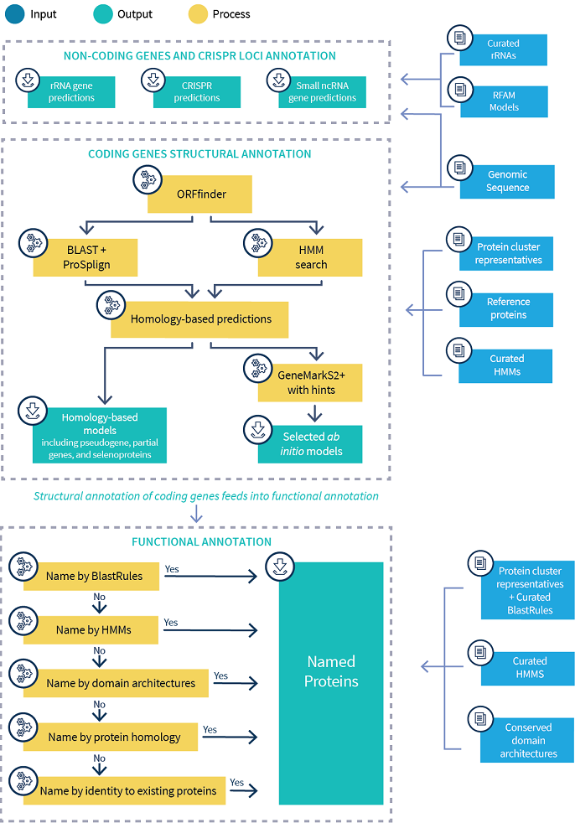
NCBI PGAP Prokaryotic Genome Annotation Pipeline

Slide 3
Bacteria & Archaea Gene Prediction
Gene model used by all ab initio gene finder
Traits a gene finder is looking for:
Ribosome-binding site within a predicted distance from a start codon
One of 3 start codons
One of 3 stop codons
No frame interruptions
Most gene finders do not handle point mutations that generate missense proteins or superfluous stop codons
Ribosome binding site
open reading frame
Start codon:
ATG, GTG, TTG
Stop codon:
TAG, TAA, TGA

Slide 4
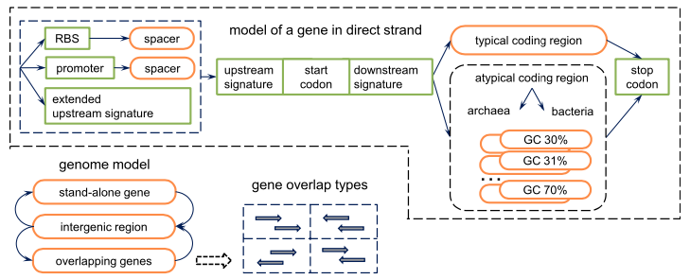
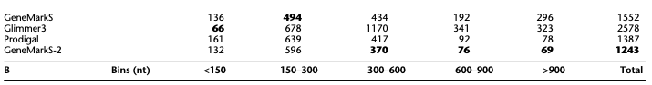
Common Gene Prediction Tools
GeneMarkS-2 (2018)
Prodigal (2012)
Predicts protein-coding genes
Handles draft genomes and metagenomes
Runs quickly
Runs unsupervised (unsupervised ML algorithm)
Handles gaps, scaffolds, and partial genes
Identifies translation initiation sites
Outputs detailed summary statistics for each genome
Missed annotated genes (FN)
Currently used by NCBI PGAP
Currently used by JGI
Lomsadze (2018)

Slide 5
Eukaryotic Gene Prediction
Eukaryotic gene prediction requires consideration of:
Introns
Exons
Untranslated regions (UTRs)
Splice forms
http://www.garlandscience.com/textbooks/0815340249.asp?type=artwork

Slide 6
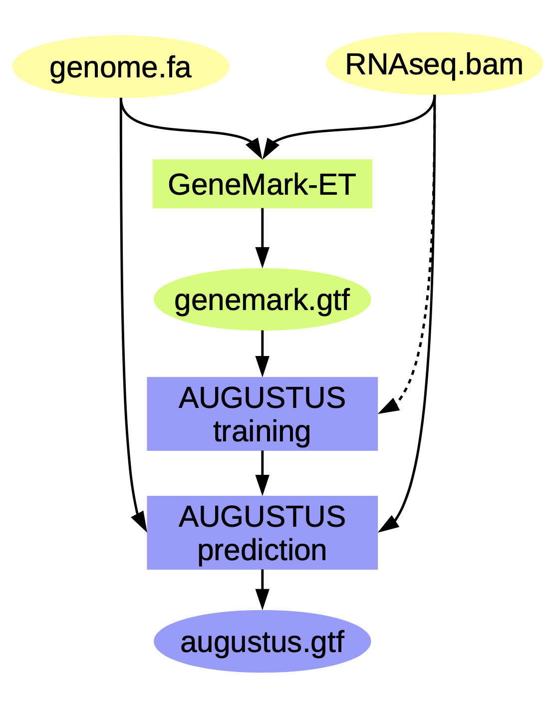
Common Gene Prediction Tools
Braker2 (2018)
Preparation steps:
Create a repeat library and mask your genome with RepeatMasker
Trim and align RNA-seq to genome
Align transcripts, ESTs, or long transcript to genome with splice aware aligner
RUN Braker2
BRAKER1, a combination of GeneMark-ET and AUGUSTUS, that uses genomic and RNA-Seq data to automatically generate full gene structure annotations in novel genome
BRAKER2 is an extension of BRAKER1. BRAKER2 reaches high gene prediction accuracy even in the absence of the annotation of very closely related species and in the absence of RNA-Seq data.
trimgalore
Hisat2
Picard

Slide 7
Common Gene Prediction Tools
MAKER (v3 2020)
Steps:
Mask out repeats
Align EST to genome
Align proteins to genome
Produce ab initio predictions
Synthesize into final predictions
MAKER is an annotation pipeline, not a gene predictor. MAKER does not predict genes, rather MAKER leverages existing software tools (some of which are gene predictors) and integrates their output to produce what MAKER finds to be the best possible gene model for a given location based on evidence alignments.

Slide 8
Common Gene Prediction Tools
Bacteria and Archaea
Eukaryotes
ab initio prediction → uses a set of basic rules to determine open reading frames
The more “standard” the genome, the better the tool works
Possible to design rules for alternative genotypes
Reliant on previous data sets
Transcriptomic
Close evolutionary relative
Conglomeration of multiple tools and datasets leveraging as much data as possible

Slide 9
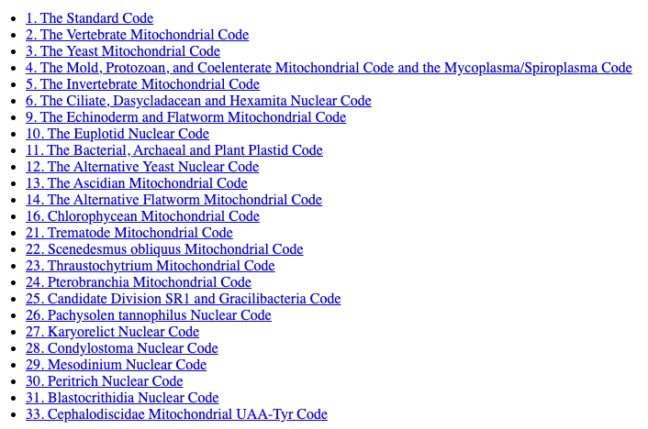
Translation tables
33 translation tables – organism dependent
https://www.ncbi.nlm.nih.gov/Taxonomy/Utils/wprintgc.cgi

Slide 10
Lesson 2
Predicting function using orthologous comparisons

